Slide 1

SurplusSaver: Fighting Food Waste in Our Region

Slide 2
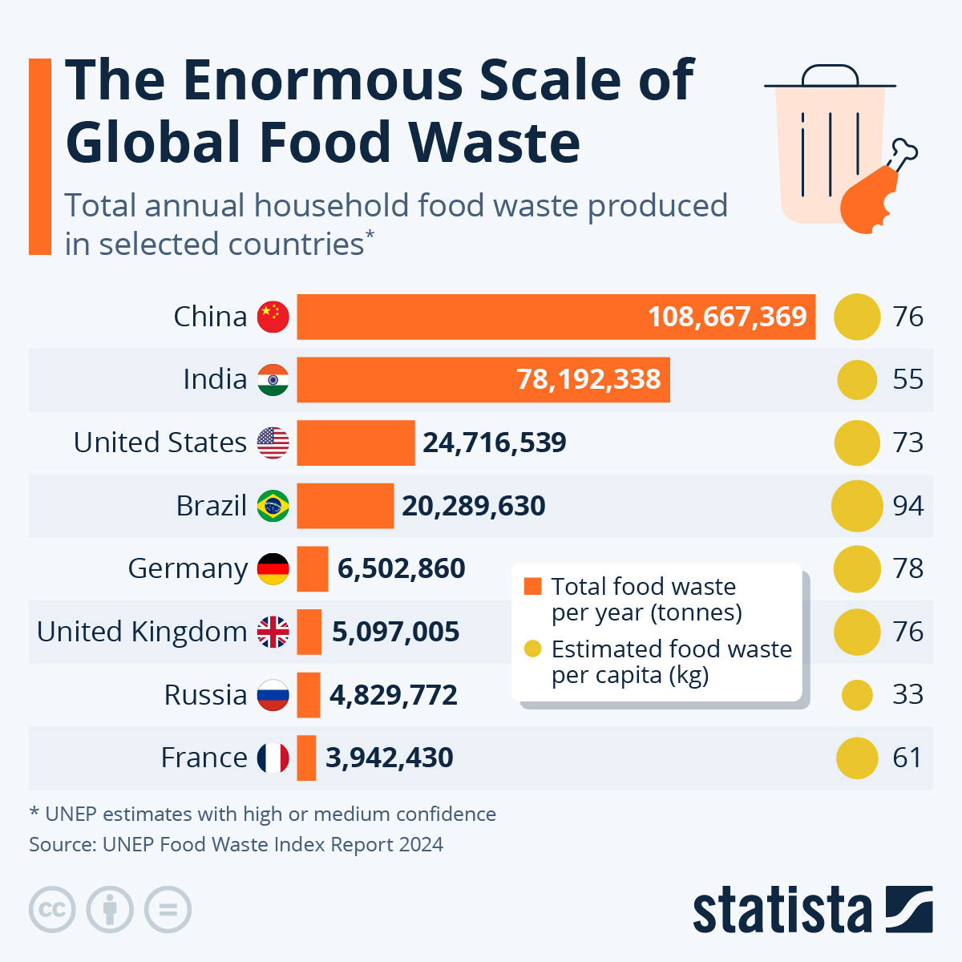
Problem Statement
Every year, shops in our region discard tons of unsold food—perfectly edible but past its prime sales window. Businesses lose money, and waste piles up.
(Hypothetical) "30% of food produced locally goes unsold; 1.5 tons of CO2 emitted per ton of wasted food."

Slide 3
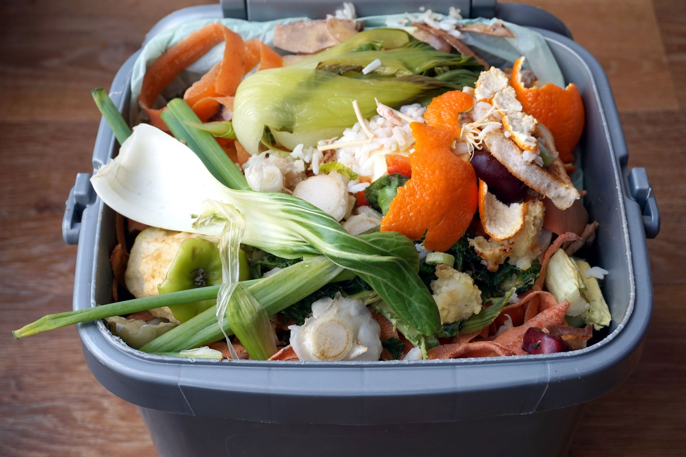
Food waste is a global issue, but it’s also local. Shops here throw out surplus daily—think bakeries with day-old bread or grocers with near-expiry produce.
This isn’t just an environmental problem; it’s a lost opportunity for businesses and budget-conscious customers.

Slide 4
Solution:SurplusSaver
SurplusSaver connects local shops with customers to sell unsold food at a discount via ‘Surprise Bags.’ Think $5 for $15 worth of goods!
Features:
Businesses list surplus items.
Customers buy and pick up discounted bags.
Real-time availability and notifications.

Slide 5
Scope of the Project
Build a functional MVP with:
User registration (shops and customers).
Listing and browsing Surprise Bags.
Purchase and pickup system.
Real-time updates and notifications.
Out of Scope (for now): Delivery, advanced analytics, multi-region support.
Your goal is an MVP: a working app with core features. Users sign up, shops list bags, customers buy them, and pickups happen.

Slide 6
Feasibility Analysis
Market Need: No similar app in our region; local shops and eco-conscious customers are untapped.
Tech Stack: FastAPI, Redis, and Celery are lightweight, modern, and within your skillset.
Time: 1-2 weeks is enough for an MVP with your Redis and Celery knowledge.
Cost: Minimal—open-source tools, basic hosting (e.g., Heroku free tier).

Slide 7
Technical Overview
Backend: FastAPI (API and logic).
Cache/Message Broker: Redis (speed and updates).
Task Queue: Celery (notifications and scheduling).
Frontend: Your choice (e.g., React, Vue, or HTML).
Database: SQLite (simple) or PostgreSQL (scalable).
Here’s the big picture: FastAPI runs the show, Redis keeps it fast, Celery handles background tasks, and the frontend ties it together.
You’ve got flexibility on the frontend—focus is on the backend where your skills shine.

Slide 8
Roadmap
Week 1 (4 Lessons):
Lesson 1: Setup FastAPI, Redis, Celery, and basic DB (SQLite).
Lesson 2: Core backend - Shop registration and bag listing endpoints.
Lesson 3: Purchase flow - Buy endpoint + Redis for bag availability.
Lesson 4: Celery task for pickup reminder + basic frontend (list bags).
Week 2 (4 Lessons, Optional):
Lesson 5: Add user registration (customers) + frontend buy button.
Lesson 6: Redis caching for nearby bags + basic testing.
Lesson 7: Fix bugs, add pickup confirmation (QR code or ID).
Lesson 8: Demo prep - simple UI tweaks and practice run.

